Slide 1
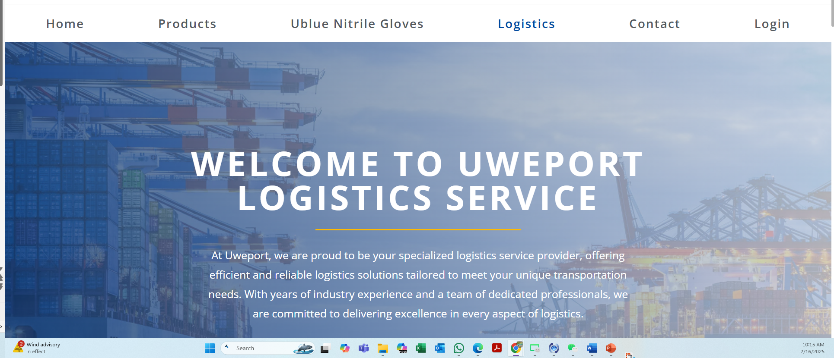
New home contents PPT-2-4
Move Logistics after home, redesign this page
Remove this from manu

Slide 2
Home
1. About Us
Uweport is your all-in-one solution for supply chain management, specializing in logistics, procurement, and wholesale distribution.
Logistics: We provide efficient and reliable logistics solutions tailored to meet your unique international transportation needs.
Wholesale & Distribution: By connecting manufacturers directly with end users, we streamline the supply chain, reducing costs and maximizing efficiency.
Procurement: Partnering with manufacturers worldwide, we source high-quality products at competitive prices.
At Uweport, we are committed to optimizing your supply chain with seamless and cost-effective solutions.

Slide 3
2. Quality Standards
All products and services comply with industry-approved standards.
Each product adheres to a rigorous set of criteria, regulations, and guidelines established by authoritative organizations and regulatory bodies.
These standards define precise specifications for design, construction, performance, testing, and procedures.
Our quality control process ensures the use of high-quality materials, ergonomic design, durability, and resistance to specific hazards.

Slide 4
3. Why Choose Us?
At Uweport, we are committed to optimizing your supply chain with seamless, cost-effective, and reliable solutions. Here’s why businesses trust us:
Global Reach – Our extensive network spans international markets, ensuring access to high-quality products worldwide.
Efficiency & Reliability – We provide tailored logistics solutions that streamline transportation, minimize delays, and enhance supply chain efficiency.
End-to-End Solutions – From procurement to distribution, we offer a comprehensive approach to simplify your supply chain operations.
Customer-Centric Approach – Our team is dedicated to providing personalized service and innovative solutions to meet your unique business needs.
Partner with Uweport and experience a smarter, more efficient way to manage your supply chain.

Slide 5
Uweport Logistics Services
At Uweport, we take pride in being your trusted logistics partner, providing efficient and dependable transportation solutions tailored to your specific needs. Backed by years of industry experience and a team of dedicated professionals, we are committed to delivering excellence at every stage of the logistics process.
Our Mission ( remove this)
Expertise and Experience (no change)
The market we serve
U.S, Mexico, South America (Peru, Brazil)

